Slide 1
Introduction to .NET
Florin Olariu
“Alexandru Ioan Cuza”, University of Iași
Department of Computer Science

Slide 2
Agenda
Demo
Intro
What is serverless computing?
Serverless frameworks
Demo 1
Demo 2

Slide 3
Demo
Notes:
Cognitive services
ML
Azure Functions
Debugging for Azure Functions
VS 2019

Slide 4
Intro

Slide 5
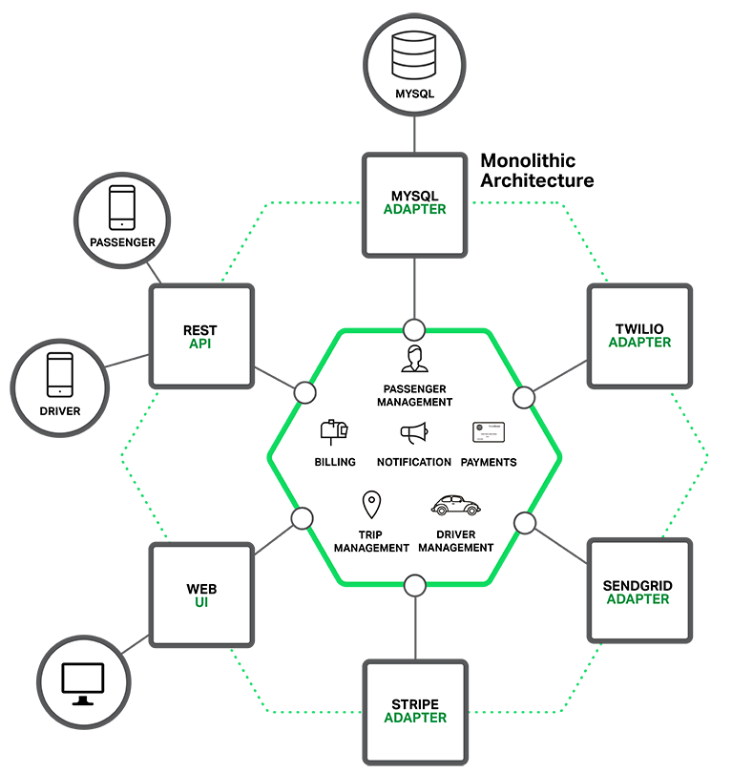
Intro
Notes:
Monolithic application example (Taxi app):
Multiple third parties
Complex business: payments, billings, trips etc
One single DB
How long does the deployment take? Continuous deployment?
How long does it take to understand a structure like this?
For more scalability, multiple copies of the whole app need to be put on different machines
Technologies up to date?

Slide 6
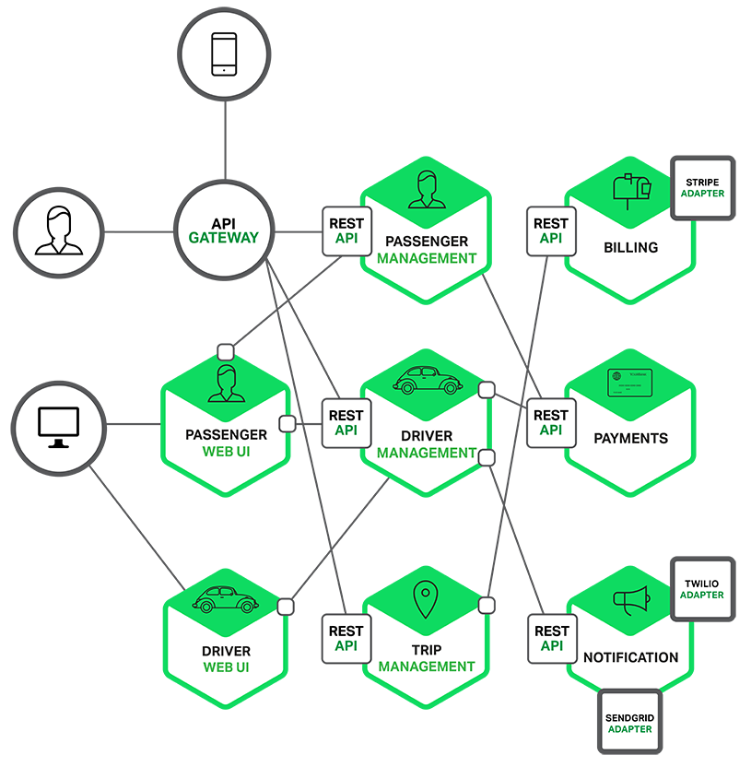
Intro
Notes:
Loosely coupled
Some microservices call other microservices - SRP (Single responsibility)
API Gateway pattern -> figures out which API to call
Technologies independant
Deployment complexity increases

Slide 7
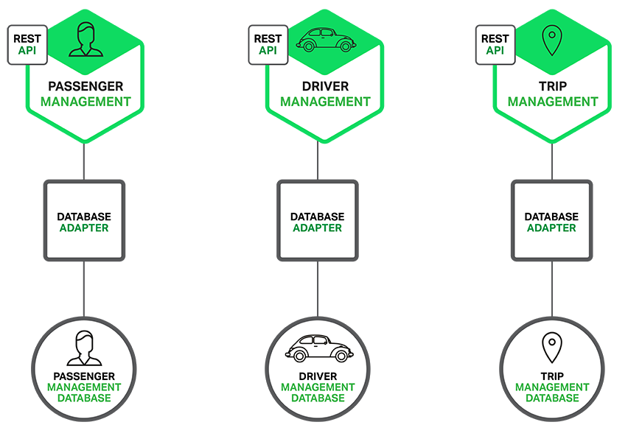
Intro
Notes:
Easier to test, but hard to test E2E
How to sync databases? Saga pattern -> Events are triggered when the data is changed
How to manage calls to multiple services (databases)? CQRS pattern

Slide 8
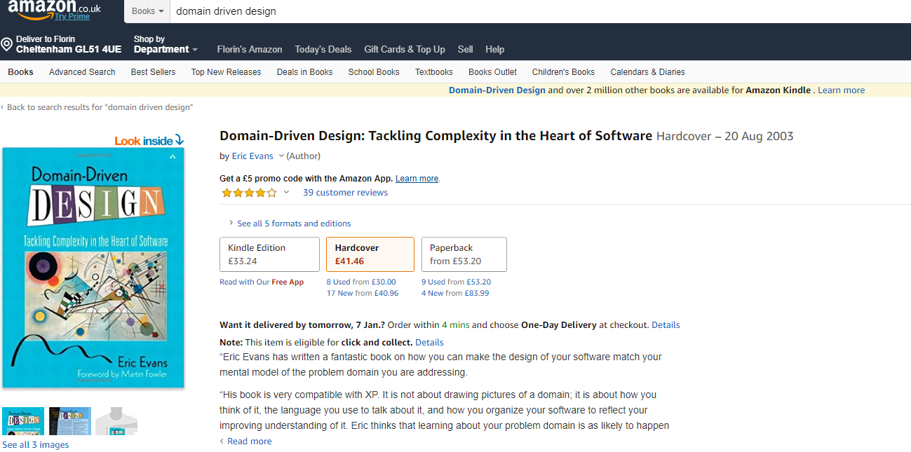
Intro

Slide 9
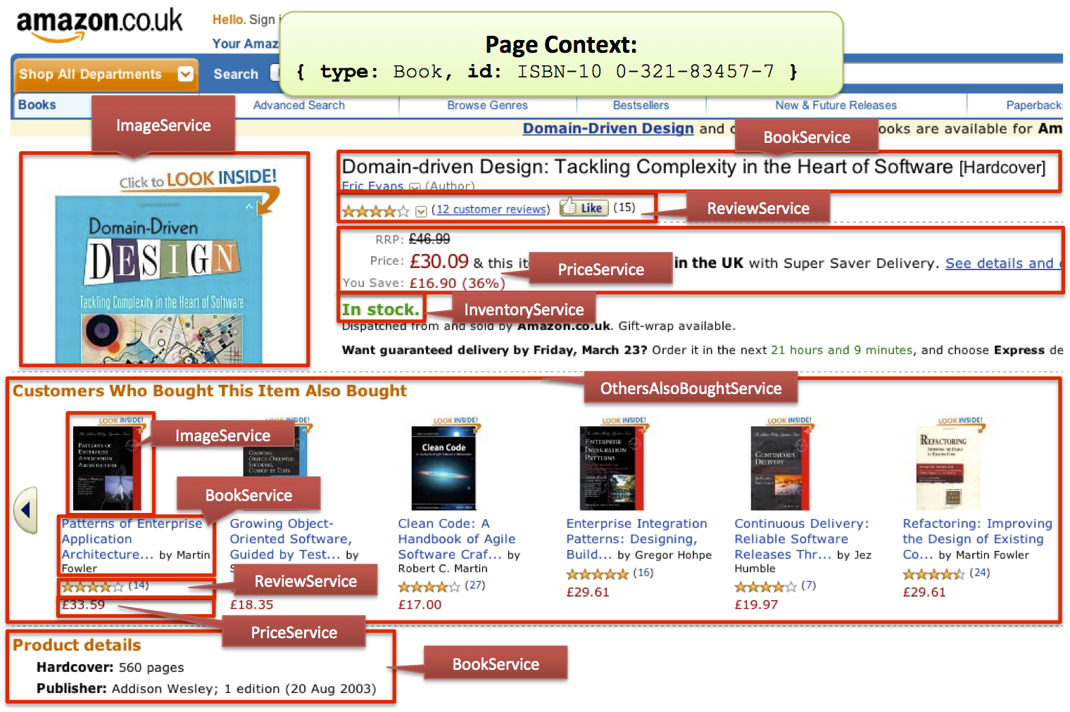
Intro
Notes:
Fault tolerance: what happens when a microservice fails? - image
How many microservices does Amazon have?

Slide 10
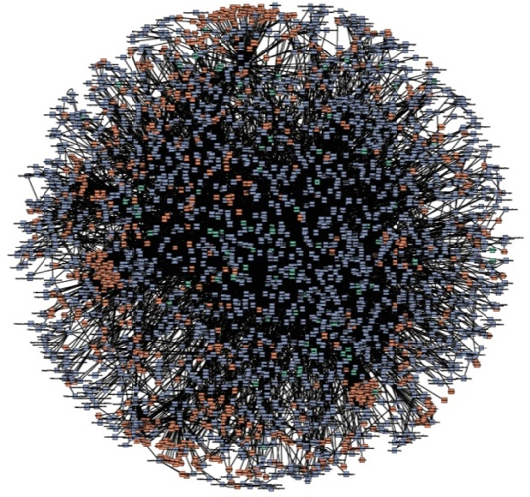
Intro
Notes:
2009
Fifty million deployments per year
As cloud computing has evolved, so too have the systems and services we software developers have at our disposal.
One of the most revolutionary tools in this domain is lambda functions, or more accurately, Functions as a Service.
A step beyond microservices, being able to run, manage, and deploy a single function as a different entity has pushed us into the realm of nanoservices.

Slide 11
What is serverless computing?
Notes:
Most people can agree on a few key attributes.

Slide 12
What is serverless computing?
No operating systems to configure or manage
Notes:
Arguably, this is where the term serverless came from and is at the heart of this entire movement.
If we look back not too long ago, we can see a time when operations teams had to purchase physical hardware, mount it in a data center, and configure it.
All of this was required before engineers even had the chance of deploying their software.
Cloud computing, of course, revolutionized this process and turned it upside down, putting individual engineers in the driver's seat.
With a few clicks or API calls, we could now get our very own virtual private server (VPS) in minutes rather than weeks or months.
While this was and is incredibly enabling, most of the work of setting up systems remained.
A short list of things to worry about includes the following:
Updating the operating system
Securing the operating system
Installing system packages

Slide 13
What is serverless computing?
No operating systems to configure or manage
Pay-per-invocation billing model
Notes:
Serverless platforms, on the other hand, the bill only while the code is being executed.
They are designed and shine for systems that are stateless and have a finite, relatively short duration.
As such, billing is typically calculated based on a total invocation time.
This model works exceptionally well for smaller systems that may get only a few calls or invocations per day.
On many platforms, it's possible to run a production system that is always available completely for free. There is no such thing as idle time in the world of serverless.

Slide 14
What is serverless computing?
No operating systems to configure or manage
Pay-per-invocation billing model
Ability to automatically scale with usage
Notes:
Different cloud providers provide the ability to scale up or down (that is, be elastic) based on various parameters and metrics.
Talk to DevOps folks or engineers who run systems with autoscaling and they will tell you it's not a trivial matter and is difficult to get right.

Slide 15
What is serverless computing?
No operating systems to configure or manage
Pay-per-invocation billing model
Ability to automatically scale with usage
Built-in availability and fault tolerance
Notes:
Servers, real or virtual, can and do fail.
Since the hosts that run your code are now of little or no concern for you, it's a worry not worth having.
Just as the management of the operating system is handled for you, so too is the management of failing servers.
You can be guaranteed that when your application code should be invoked, it will be.

Slide 16
Serverless frameworks
Notes:
An essential difference between web frameworks and serverless frameworks is that serverless frameworks often help with the management of application code on a serverless platform.

Slide 17
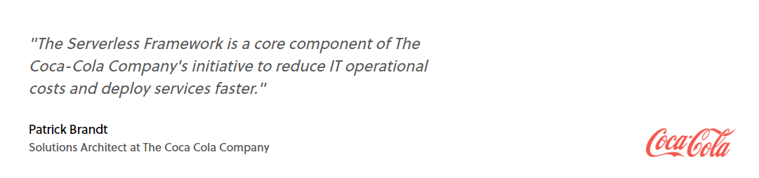
Serverless frameworks

Slide 18
Serverless frameworks
Apex
Serverless
ClaudiaJS
Kappa
SAM (Serverless Application Model from AWS)
Chalice (from AWS)
Zappa

Slide 19
Serverless frameworks
https://serverless.com/

Slide 20
Demo 1
Microsoft Azure - Azure Portal

Slide 21
Demo 2
https://github.com/markheath/funcs-todo-csharp

Slide 22
Resources
Microservices
http://microservices.io/
https://martinfowler.com/articles/microservices.html

Slide 23


Slide 24
Thanks!
☺
florin.olariu@centric.eu

